Slide 1

C Programming
Week 05 21.11.23. 07:00 PM
Second-half period / CMD-C_Programming Study
Mentor : Jh9892

Slide 2
INDEX
INDEX
🔥 Ｃ Language – Pointer
🔥 C Language – Structure

Slide 3
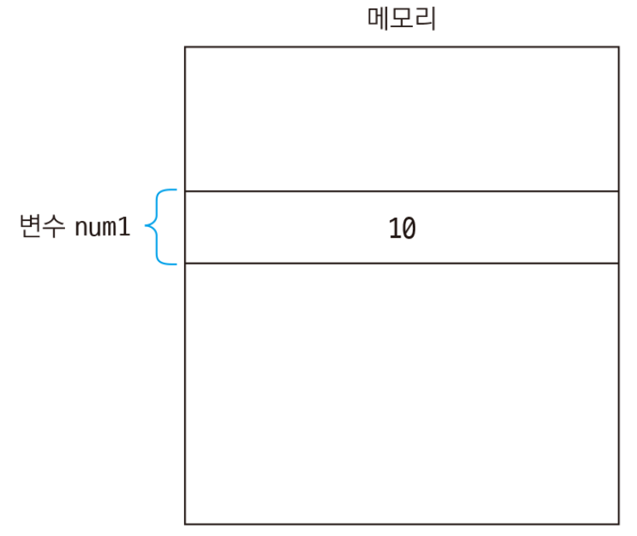
Pointer

Slide 4
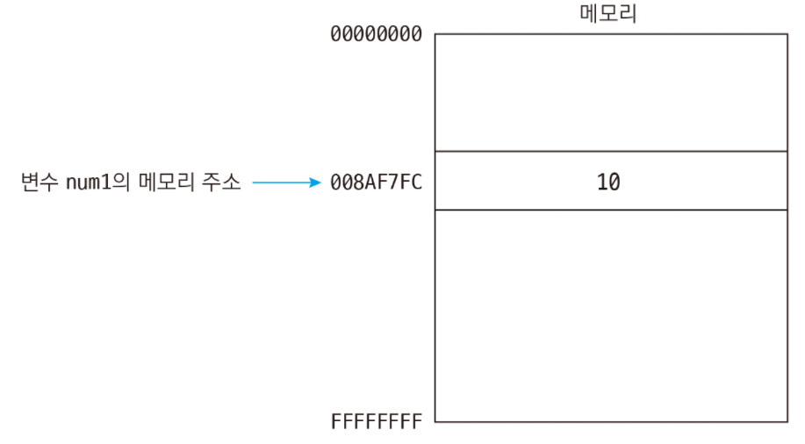
Pointer

Slide 5
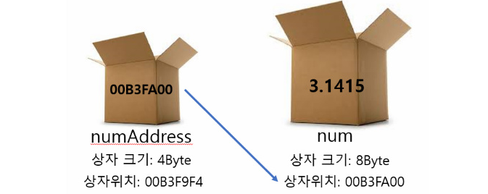
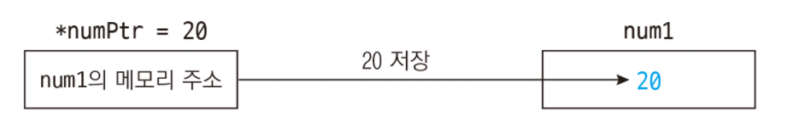
Pointer

Slide 6
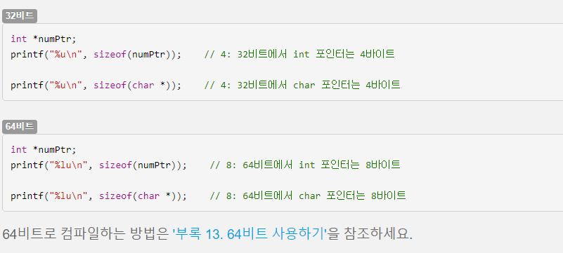
Pointer

Slide 7
Structure
Please read to sample files :D

